Slide 1



AI Master Class series – Day 29
AI Cloud

Slide 2
AI in Cloud
There are hundreds of AI solutions out there. And for most companies accessing them through cloud services is the easiest way of starting to get a feeling for AI projects.
And there are more benefits of going with a large vendor first: There is for example some stability regarding up-times, API accessibility, customer support and most importantly their unfair advantage in the forms of the vast amounts of data to train algorithms with.

Slide 3




Clouds for AI
cloud.google.com
azure.microsoft.com/en-in/
aws.amazon.com/
www.ibm.com/in-en/watson

Slide 4



Slide 5
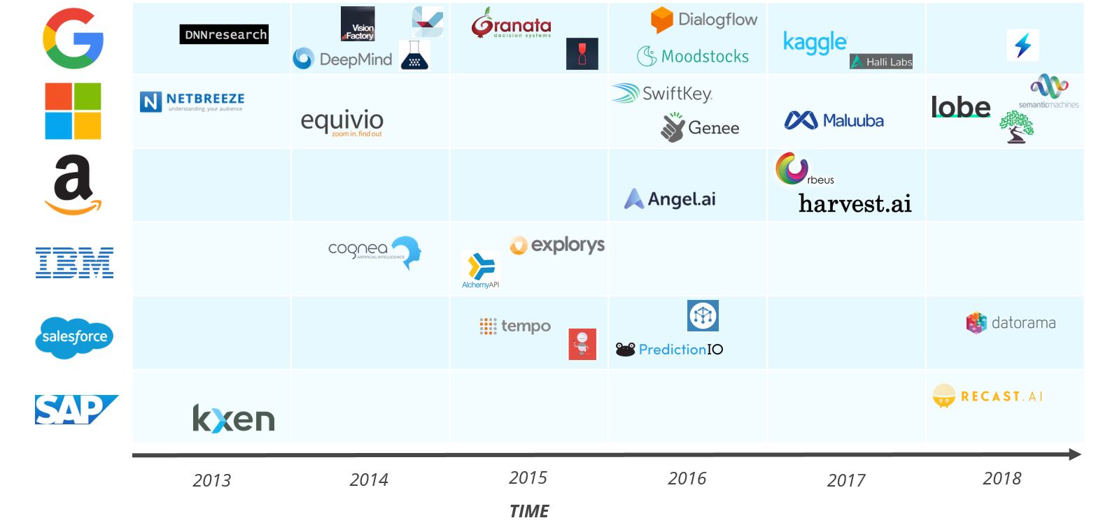

Slide 6

Paper Space
Paperspace is the cloud platform built for the future. Paperspace powers applications from machine learning to 3D visualization to meet the needs of individuals
Paperspace wraps complex infrastructure in a simple software layer unlocking on-demand computing power in an easy-to-use interface.

Slide 7

Google Colab
Colab notebooks allow you to combine executable code and rich text in a single document, along with images, HTML, LaTeX and more.
Colaboratory, or “Colab” for short, is a product from Google Research. Colab allows anybody to write and execute arbitrary python code through the browser, and is especially well suited to machine learning, data analysis and education.

Slide 8

! PRACTICAL SESSION !

Slide 9

Object Recognition using Imagga

Slide 10

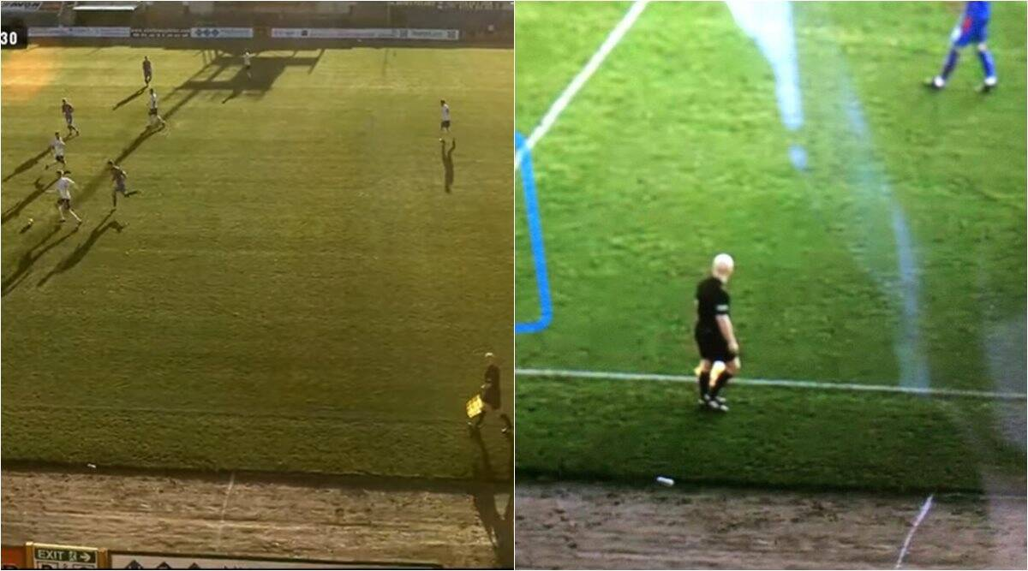
AI News – Day 29. - Funny OCT - 2020
Owing to the Covid-19 pandemic, the Inverness club had announced its decision to refrain using human camera operators and instead rely on an automated camera system to follow the action.
In a bizarre incident at a soccer game in Scotland, an artificial intelligence (AI) camera continuously tracked a bald referee mistaking it for the ball. A video of the hilarious gaffe in now going viral, leaving netizens amused online.

Slide 11
Thanks!
Tomorrow session
AI using Hardware

Slide 12
Day-29 Agenda.
01.
02.
03.
AI Cloud
List of Clouds for AI
Object Rec using Imagga cloud
04.
Q & A

